Slide 1
Angular Material
Dialogs and Popups
Lecture 6
By James(Jin) Wang
12/28/2023

Slide 2
Outline
Add Toolbar Menu
Dialog Basics
Forms
Use Datepicker
Save user and notifications

Slide 3
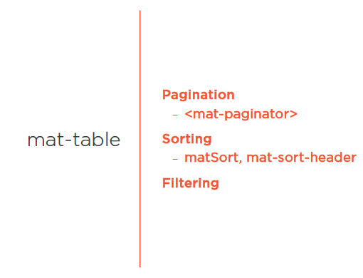
Add Toolbar Menu
  MatTable Features

Slide 4
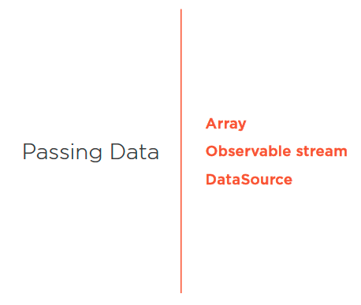
MatTable Features
  Passing Data

Slide 5
Implement MatTable
  Notes Component
  ng g c contactmanager/components/notes
  update main-content.component
  update notes.component
  Demo: notes component

Slide 6
Implement MatTable
  Implement MatTable
  https://angular-material-api.azurewebsites.net/users
  update notes.component and HTML
  Demo: notes table

Slide 7
Add Pagination
  add pagination
  update notes.component and HTML
  Demo: add pagination

Slide 8
Add Filtering
  add filtering
  https://material.angular.io/components/table/examples
  update notes.component and HTML
  Demo: add filtering

Slide 9
Add Header Sorting
  add header sorting
  https://material.angular.io/components/table/overview#sorting
  update notes.component and HTML
  Demo: add header sort

Slide 10
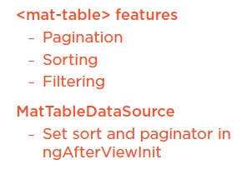
Summary

Slide 11
Assignment

Slide 12
Self Study
  Styling Application with Angular Material
  https://app.pluralsight.com/library/courses/angular-material

